Slide 1

Comparison of Consistency-based & Correlation-based Feature Selection Algorithms
Ozan GÜLHAN 150114013
Zafer Emre OCAK 150113075

Slide 2
Problem Definition
Starting the classification on large datasets without selecting the attributes could be time consuming.
Classification accuracy can be increased by selecting the most relevant attributes.

Slide 3
Motivation
Data scientists would like to know which features are most relevant with the class, so they can focus and collect more of that data in the future.
Feature selectors are being executed really fast, they look for all of the possible features based on the search algorithm that has been chosen.
To extract the most useful information from the data, and reduce the dimensionality in such a way that the most significant aspects of the data are respresented by the selected features. [1]
Best subset is given together with the merit of the subset.

Slide 4
The achieved goals...
Gained experience about utilizing two important feature selection algorithms which are correlation-based and consistency-based.
Learnt how to construct an ANN via Keras library in Python and analyze the results.
The basic usage of WEKA tool which is very handy for machine learning processes.

Slide 5
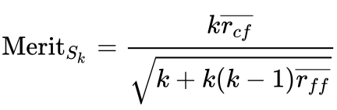
Correlation Based Feature Selection
‘Good feature subsets contain features highly correlated with the classification , yet uncorrelated to each other.’ [2]
This means that, the more a feature is uncorrelated with other features in the subset, it has a good effect on the merit of subset, also the more it’s correlated with the class , it also has a good effect.
Notes:
The following equation gives the merit of a feature subset S consisting of k features
Rcf is the average value of all feature-classification correlations
Rff is the average value of all feature-feature correlations

Slide 6
Consistency Based Feature Selection
When this algorithm takes the candidate subset, it looks for all the instances where their attribute values match but their class labels are different. This kind of patterns are inconsistent. Count of these patterns is the inconsistency count.
Inconsistency rate of a subset S is the sum of all the inconsistency counts over all patterns of the feature subset that appearsn in the data divided by total number of instances.
The less this number for a subset, the better for that subset.

Slide 7
Related Works
Chi-Square Feature Evaluator
Relief F
Information Gain

Slide 8
The subtasks
First of all, we needed to decide on a suitable dataset for our model and feature selection process.
Secondly, we constructed the artificial neural network to train the raw version and the modified version of our dataset.
After construction task, we modified the dataset in order to make it usable for feature selector algorithms and for our model.

Slide 9
The subtasks cont’d
Training and testing steps should have been observed. So initially, we trained our model with all existing features.
Later on, the first feature selection algorithm is set to work and as a result of this, some of the existing features have been expelled from our model.
Following this, the other feature selection algorithm has been used to pick up fewer features.
The observations have been recorded and got the final conclusion.

Slide 10
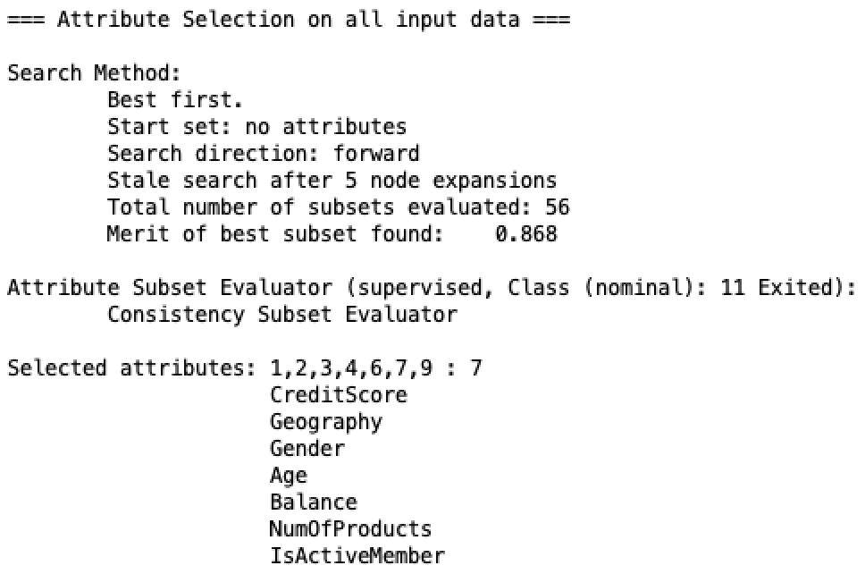
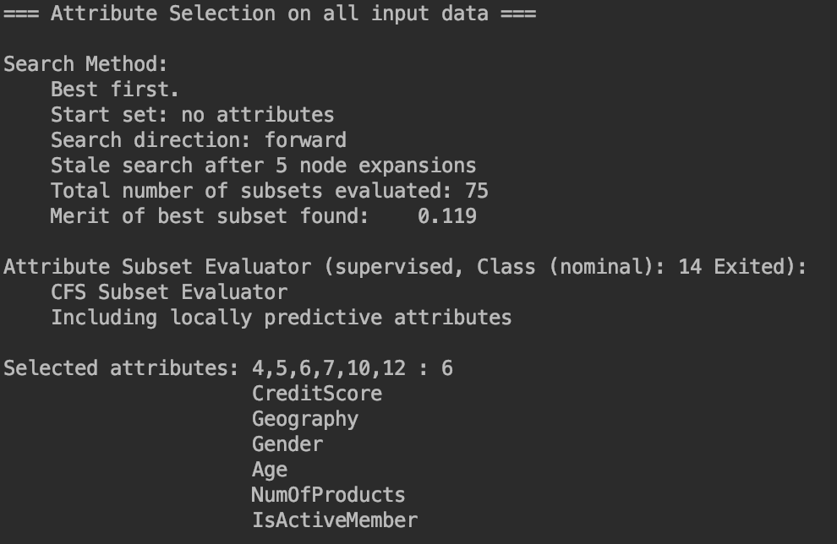
Selected Subsets
Notes:
LEFT : CORRELATION BASED
RIGHT: CONSISTENCY BASED

Slide 11
The General Comparison of Models
 | Total Features Used | Accuracy Rate | Total Duration
Raw Model | 11 | %83.60 | 83 seconds
Correlation-based | 8 | %85.61 | 85 seconds
Consistency-based | 7 | %83.41 | 80 seconds

Slide 12
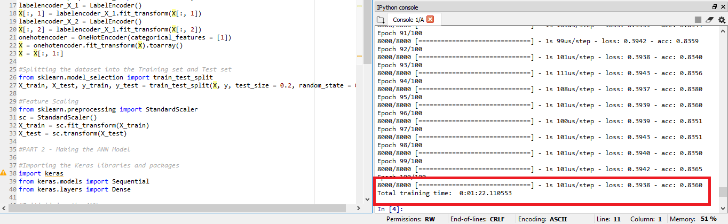
Experimental Results - 1
The image below is illustrating the performance of our model for
the raw dataset.

Slide 13
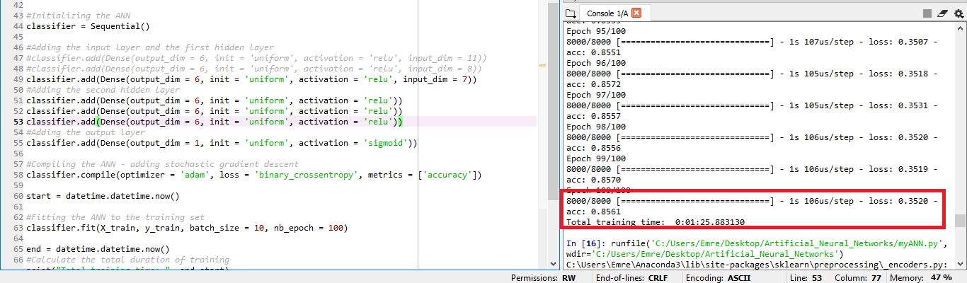
Experimental Results - 2
The image below is illustrating the performance of our model for the dataset with correlation-based feature selection has been applied.

Slide 14
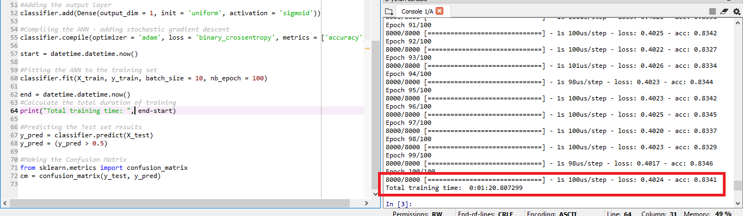
Experimental Results - 3
The image below is illustrating the performance of our model for the dataset with consistency-based feature selection has been applied.

Slide 15
Conclusion
In this project, we concluded that using feature selectors greatly contributed the performance of our model by means of both total duration of the training process and same accuracy rate with fewer number of features.
Feature selector algorithms gives different subsets for same dataset.
By using feature selectors, we find out that which features are most valuable in our classification problem.

Slide 16
References
[2] Correlation-based Feature Selection for Machine Learning, Mark A. Hall
[1] Consistency-based search in feature selection , Manoranjan Dash, Huan Liu

